Slide 1
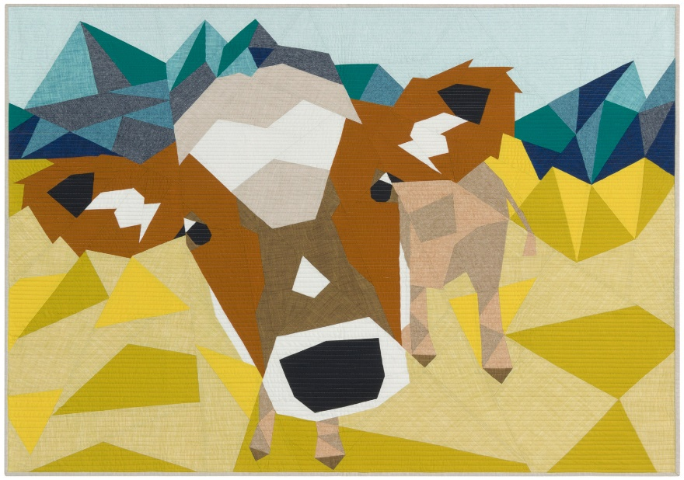
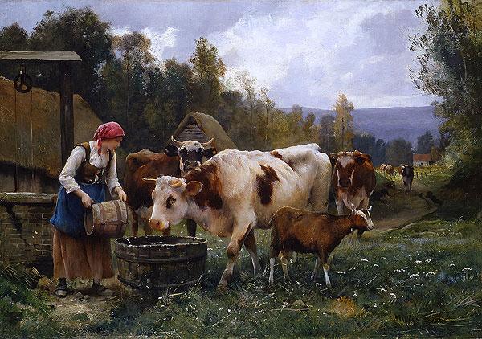
Introduction to R Programming and Collaborative Science
Pranav Pandit
BVSc & AH, MPVM, PhD
Department of Population Health and Reproduction, School of Veterinary Medicine, UC Davis

Slide 2
Learning Objectives
Introduction to R Programming
Basics of R syntax and data types
Project management
Setting up Google Colab and coding environments
Collaborative and Reproducible Science
Best Practices for collaborative research and reproducibility

Slide 3
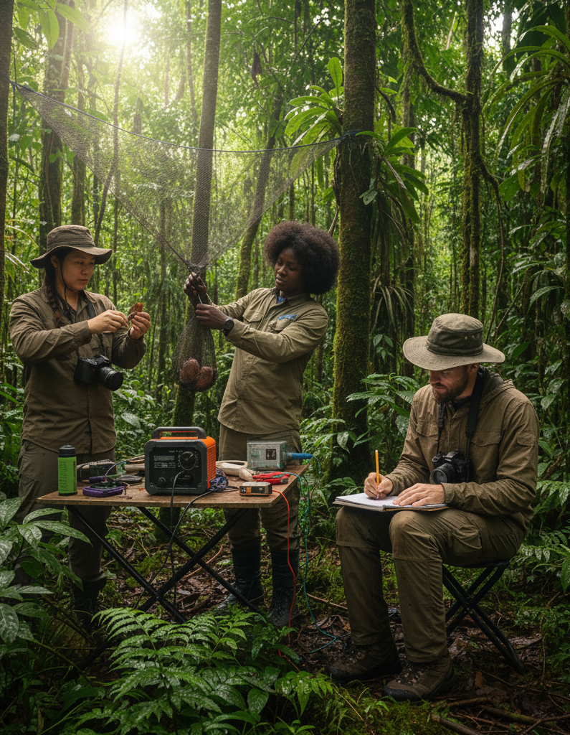
Data is valuable
Great effort is put in to collect data systematically
Hard work, meticulous planning, and recourses are put in to collect the data

Slide 4
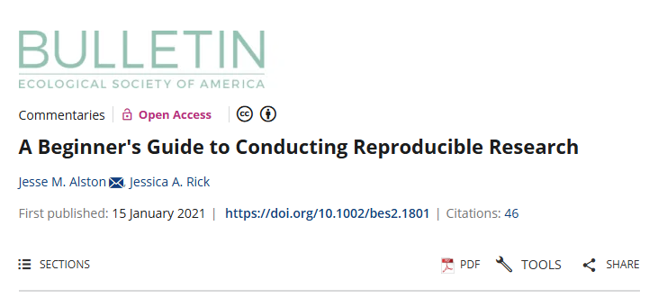
Data management
For safe storage and sharing
Generating reproducible research

Slide 5
Data management
Organize your project folder
Protect your raw data
Name your files effectively
Track your project’s changes
Backup your project

Slide 6
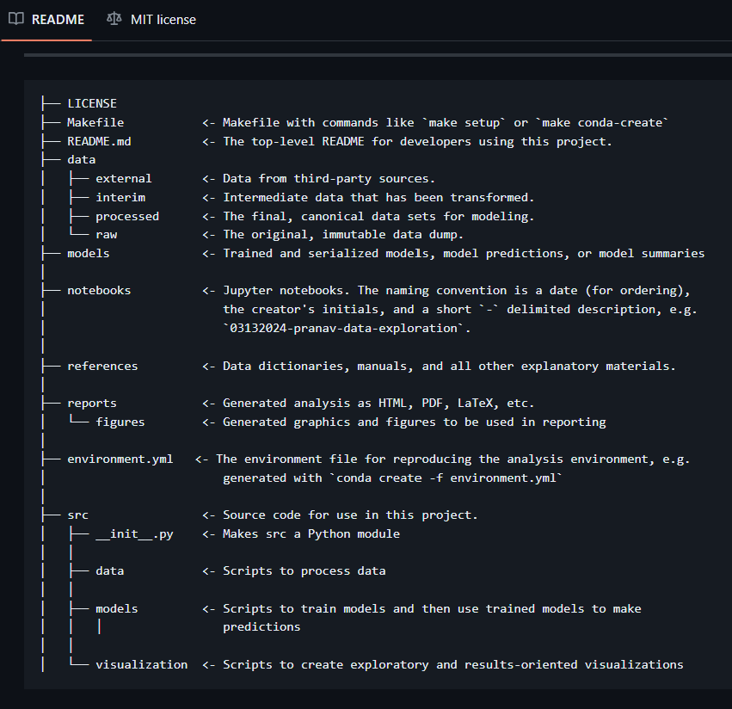
Anatomy of a Working Directory
Every R project should start with an .Rproj file (rstudio).
Keep raw data immutable — never overwrite it.
Modularize code by task.
Store outputs (plots, summaries) separately.

Slide 7
Naming Conventions
Use snake_case or kebab-case (no spaces).
Prefix with order if sequential: 01_, 02_, 03_.
Include date (YYYYMMDD) or version (v1.0).
Example: 20251020_west_nile_cleaning.R or bird_migration_2024_raw.csv.

Slide 8
Naming Conventions
e.g., camelCase or snake_case to name objects
embedding meaningful information in object names
using “_mat” as a suffix :: matrices
“_df” :: denote data frames
Descriptive
Consistent
Human readable
Machine readable

Slide 9
Data Management and Backup
Store raw and derived data separately.
Maintain a data dictionary (data_description.xlsx).
Keep metadata about data source and processing.
Backup options: Box, Google Drive, GitHub, or rsync/Backblaze.

Slide 10
Version Control you data and code
Git: https://github.com/
Drive/Box/Dropbox
Local external hard-disk

Slide 11
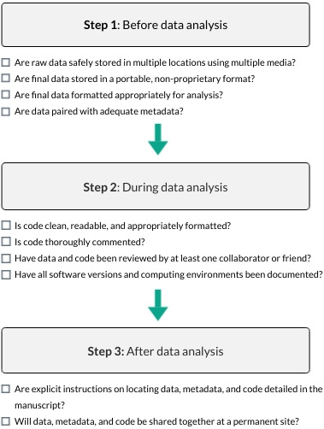
Notes:
A 10‐point checklist to guide researchers toward greater reproducibility in their research. Researchers should give careful thought before, during, and after analysis to ensure reproducibility of their work.
IF THIS IMAGE HAS BEEN PROVIDED BY OR IS OWNED BY A THIRD PARTY, AS INDICATED IN THE CAPTION LINE, THEN FURTHER PERMISSION MAY BE NEEDED BEFORE ANY FURTHER USE. PLEASE CONTACT WILEY'S PERMISSIONS DEPARTMENT ON PERMISSIONS@WILEY.COM OR USE THE RIGHTSLINK SERVICE BY CLICKING ON THE 'REQUEST PERMISSIONS' LINK ACCOMPANYING THIS ARTICLE. WILEY OR AUTHOR OWNED IMAGES MAY BE USED FOR NON-COMMERCIAL PURPOSES, SUBJECT TO PROPER CITATION OF THE ARTICLE, AUTHOR, AND PUBLISHER.

Slide 12
Important data management and wrangling concepts in R
Refer to the code demonstration
“Introduction to R.html”

